Slide 1
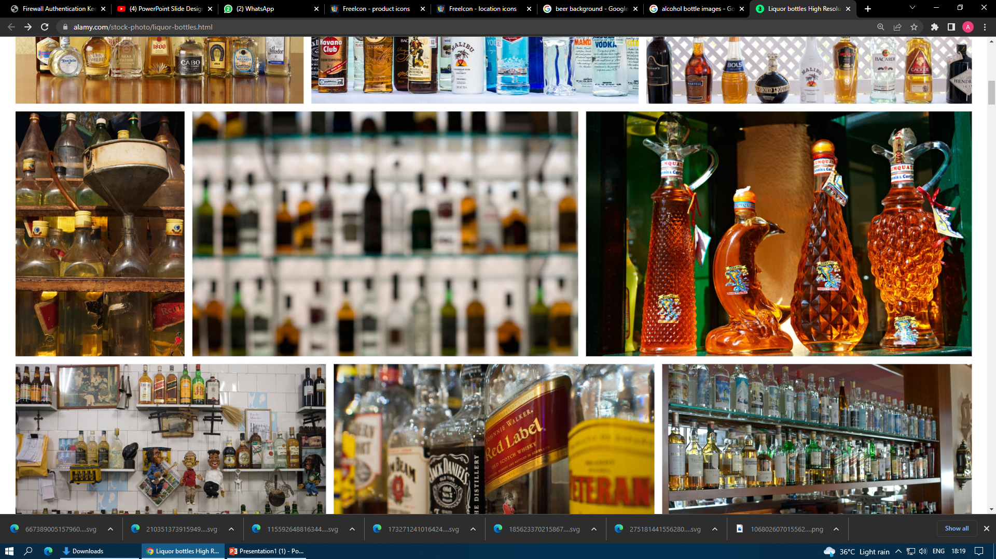
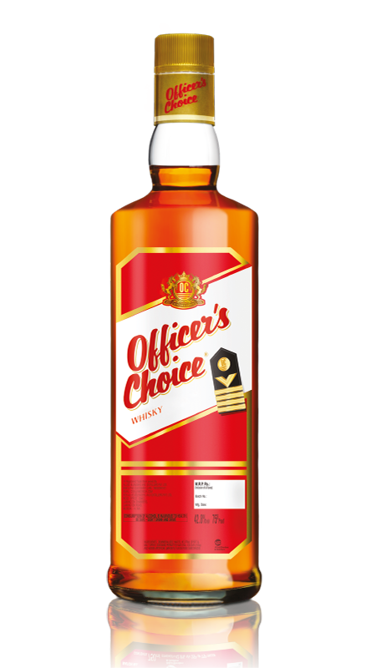

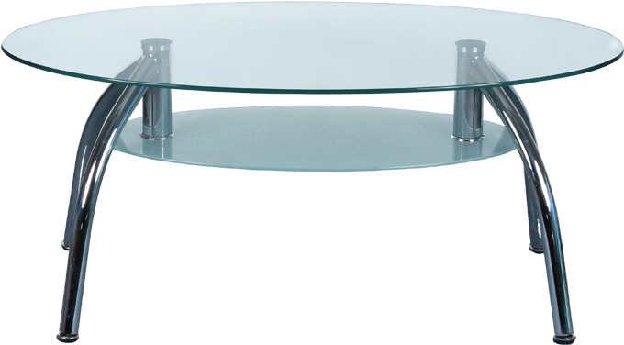
Officer’s Choice Whisky:
Spoiled for Choice
BY Anurag Kumar

Slide 2
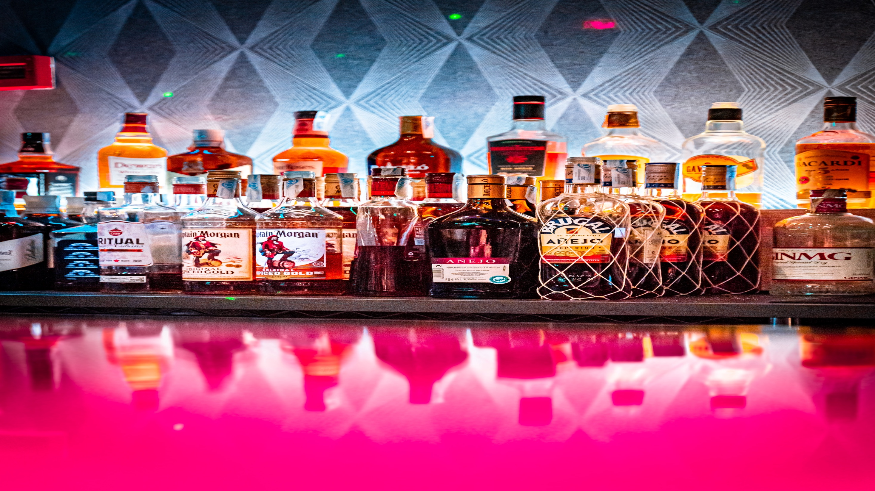
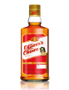
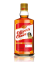

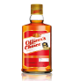
Contents
Introduction
Important Analysis
Marketing Mix
STP
SWOT
Key Competitor Analysis
Brand Asset Valuator(Y&R)
3 Pillars
Repackaging
Repositioning
Reconnecting
Marketing Ideas
Question 1
How to choose the best ad
Our Choice of ad
Question 2
Current Performance

Slide 3
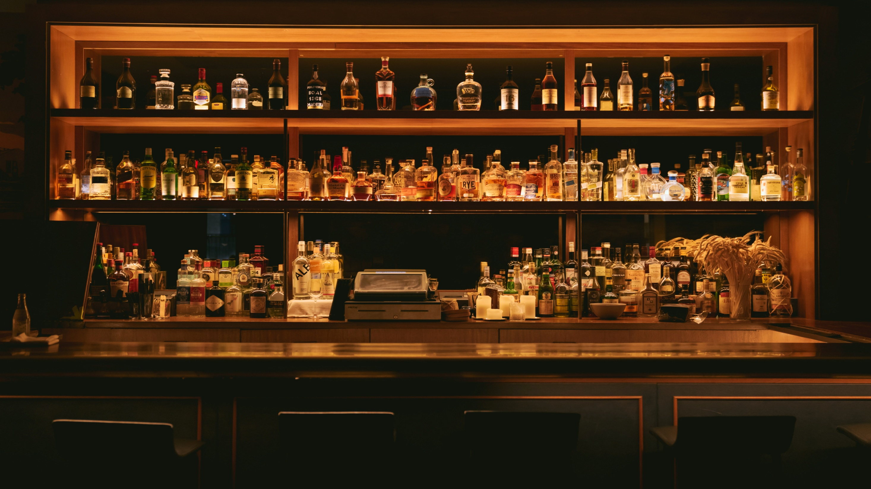
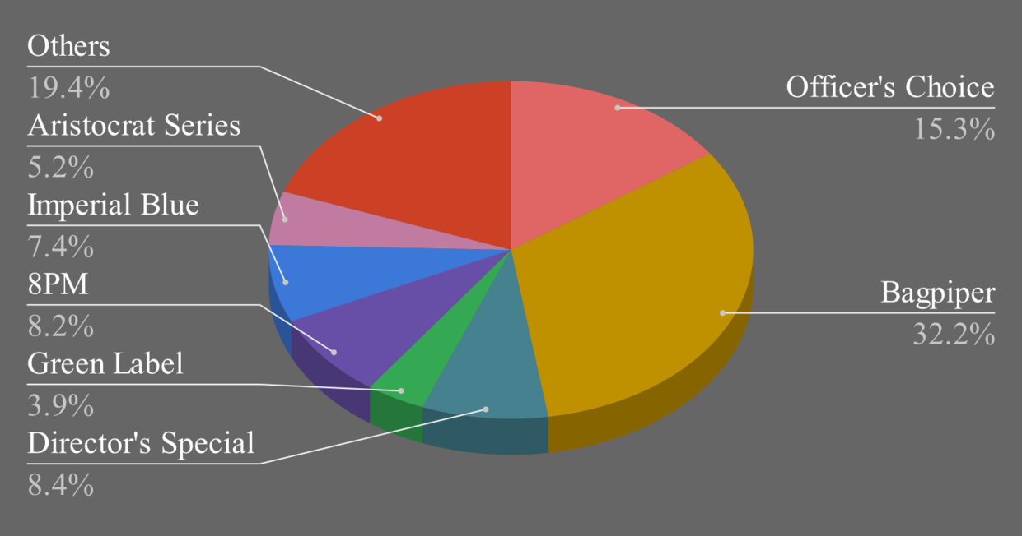
Introduction
OCW is an Indian whisky brand owned by Allied Blenders & Distillers.
ABD had been set up by Kishore Chhabria in 1988.
Sold in 29 countries
Positioned in regular whisky segment
Finely balanced malt blend
Market Share of the Regular Segment (2007-08)

Slide 4
Case Study Introduction
In 2008, OCW had 15% share of the regular whisky segment, selling 6.6 million cases.
The growth had been steady, but the brand wanted more.
OCW wanted to increase the customer base
OCW wanted to understand its brand perception
OCW wanted to define the core value of its brand equity
Research Results
Low on salience (noticeability)
Unable to connect with consumers at an emotional level
Considered stale, old, dull, boring
Price-Value perception of the brand was low
Communication was not differentiated enough
Packaging lacked a contemporary feel

Slide 5
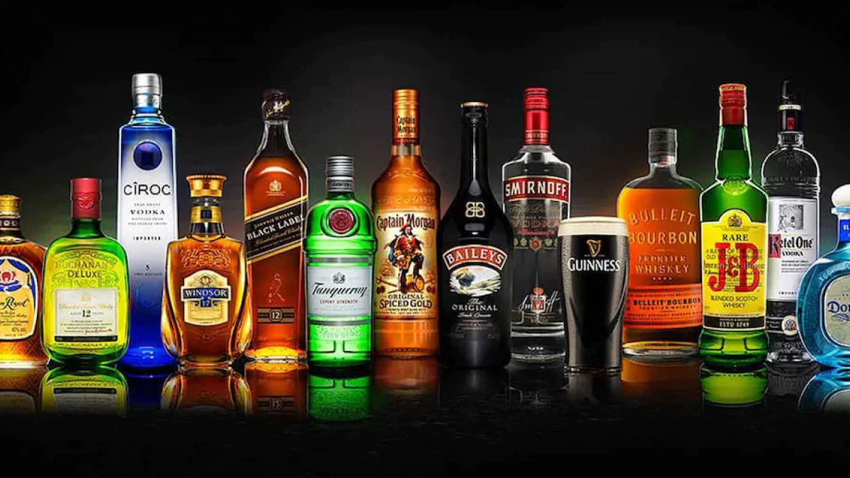




Marketing mix
Product
Price
Place
Promotion
Several finely malt blend whisky products
Quality - offer whisky made of grains rather than molasses
Pocket friendly price- 150-750 Rs
Offers under regular price segment
Available in govt. authorized/allowed liquor shops
Available in bars and clubs
Use of surrogate branding
Ads through print media, TVCs, etc.
Ads based on 'Challenge yourself' (officer's boldness)
Image of Naval officers

Slide 6
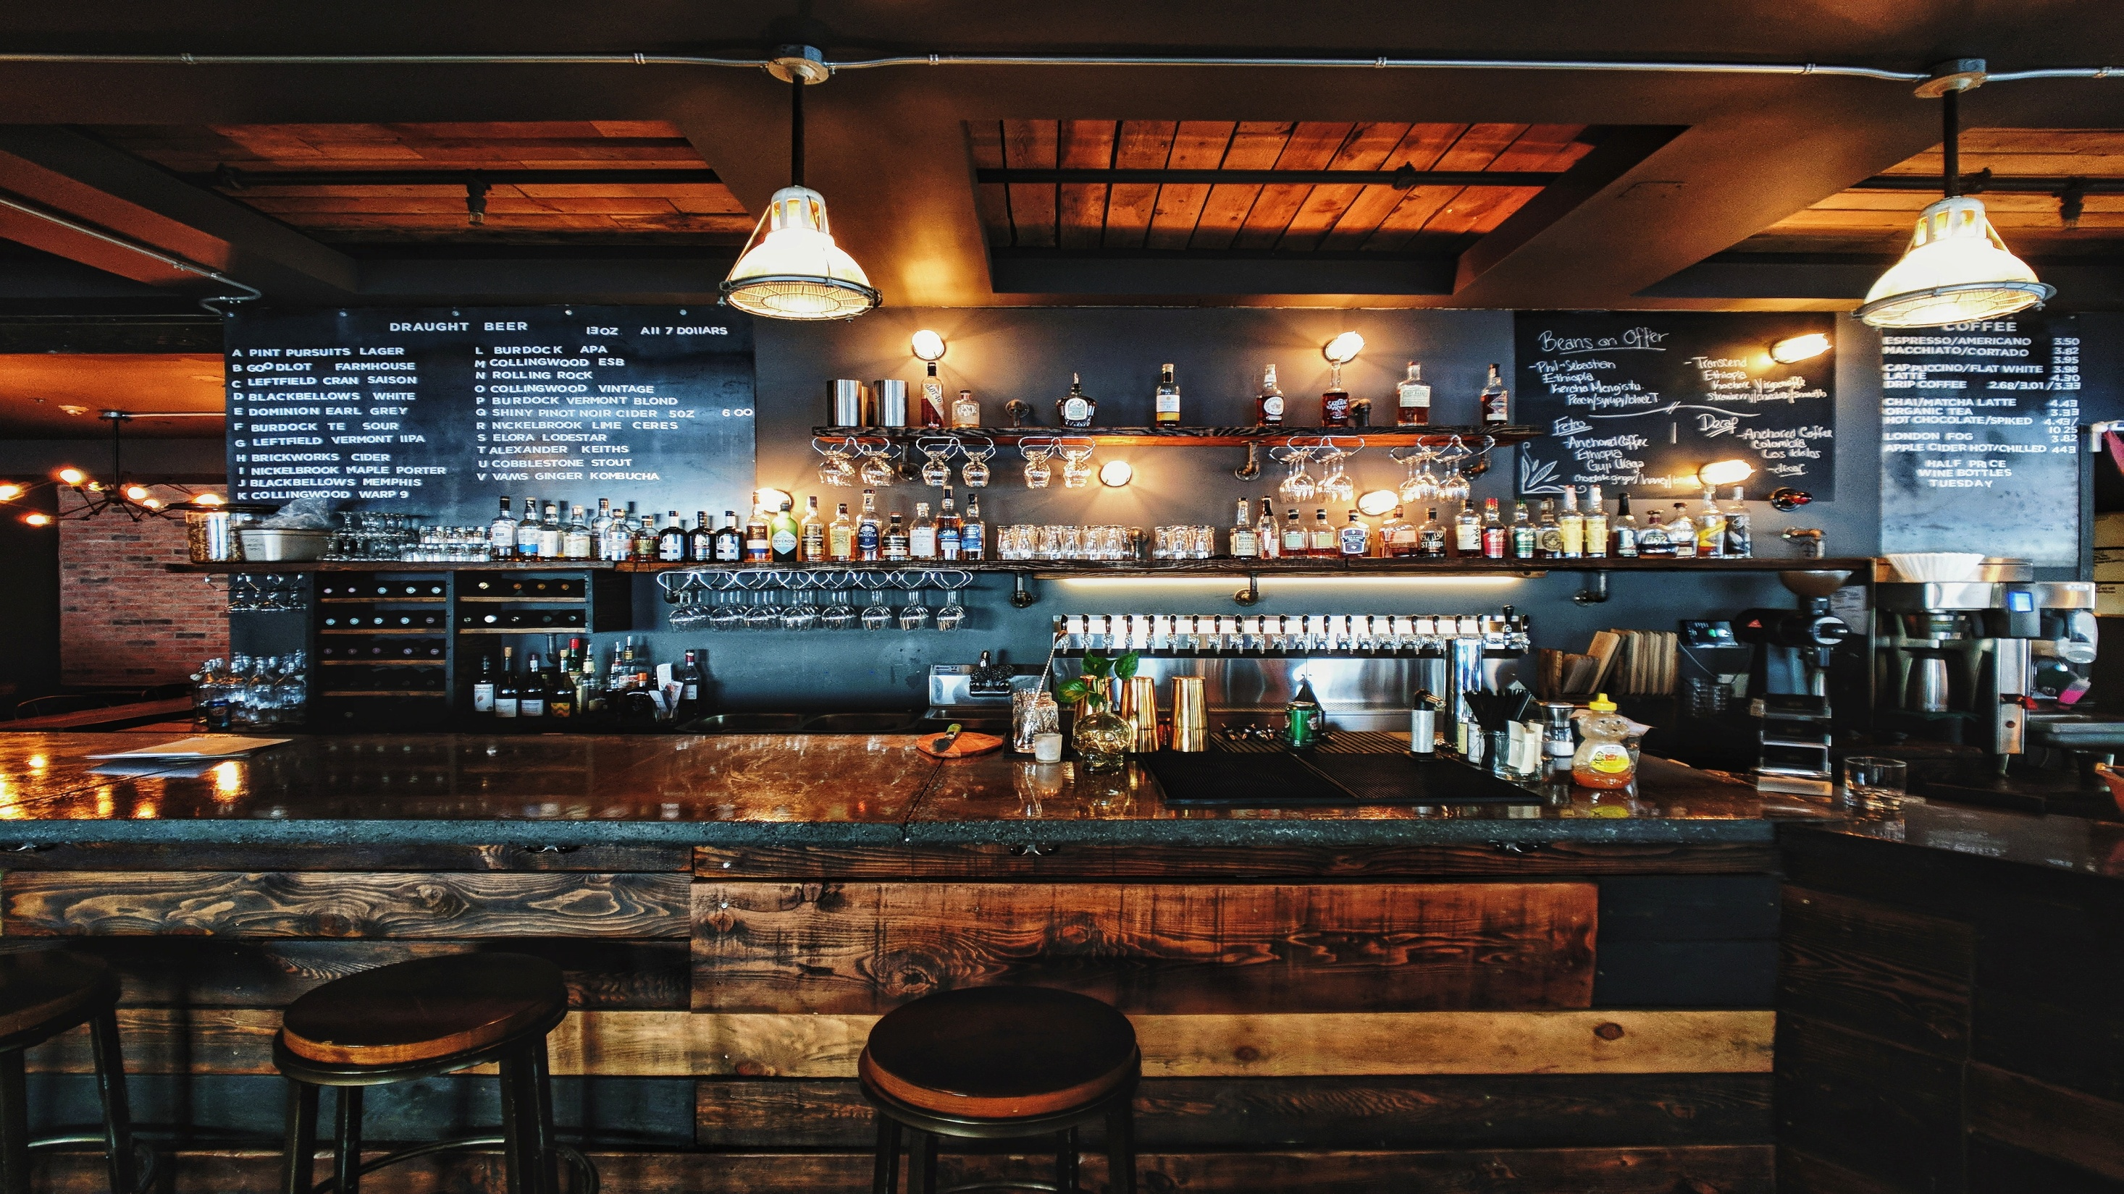



Segmentation
Price
Age
Gender
Socio-economic classification
Behavior
Lifestyle
Targeting
Segmentation
Whiskey market
Youths (21-35 years)
Male
Middle class population
Targeting
Positioning
Positioning
Affordability with class
Brand name
Focused on working class officer's life who is self-respecting and aspirational

Slide 7
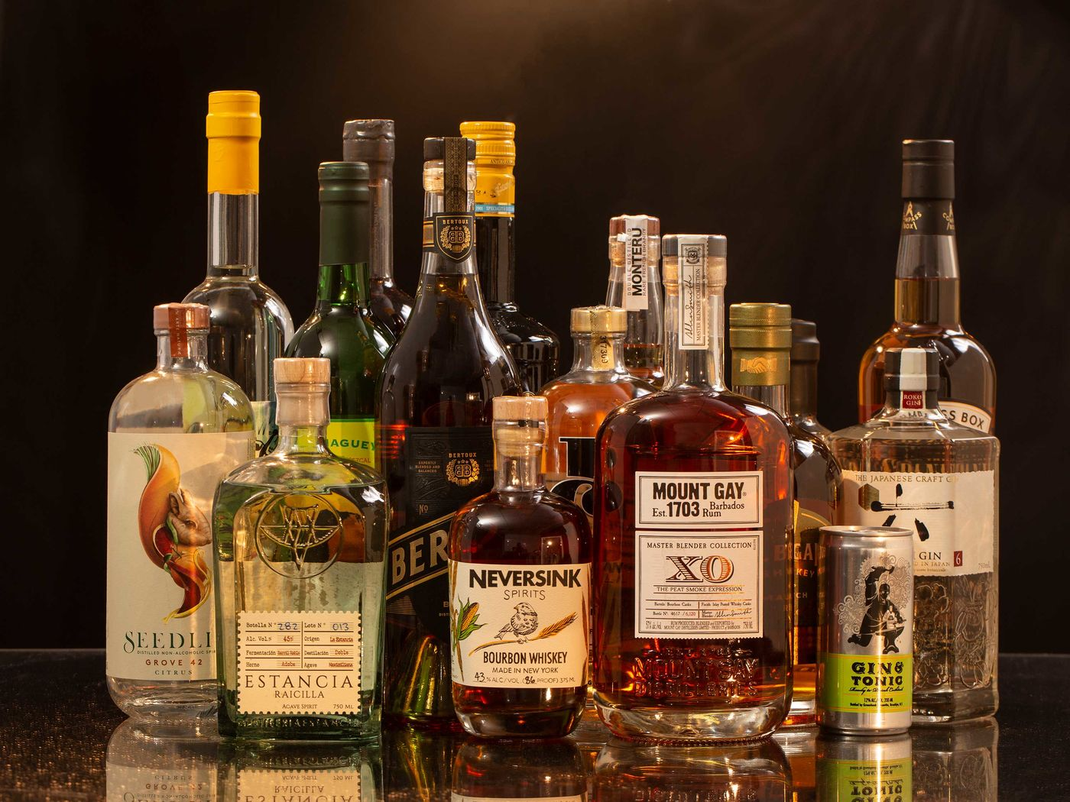




Strengths
Weaknesses
Brand name
Association with officer's acts
Management experience
It is a mature product and cannot be sold to everyone.
Emotionally detached to the youth.
Packaging
2
1
SWOT
Opportunities
4
Threats
Large market size and demand for alco-bev industry.
Reposition themselves to connect with the young.
Change in consumer preference and aspirations
Government policies and surrogate advertising
3

Slide 8
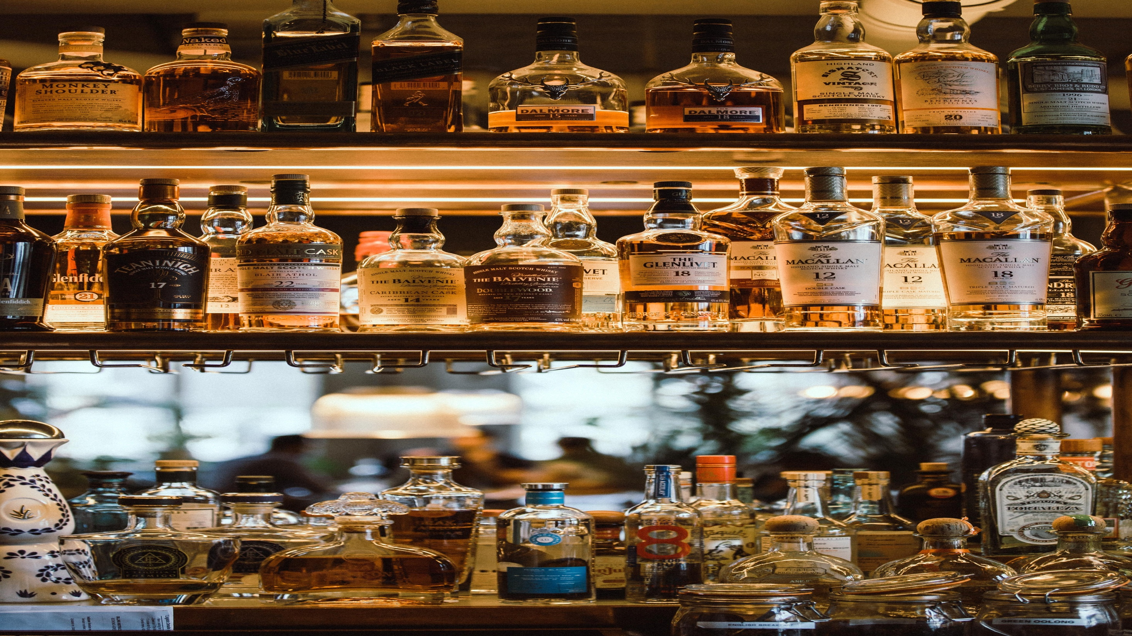
Key Competitor Analysis
Officer’s Choice
Bagpiper
Imperial Blue
Market Share
CAGR
Tagline
Positioning
Packaging
15.32%
6%
Challenge Yourself
Play with danger-prestige, responsible, masculine and courageous
Old
32.22%
12%
खूब जमेगा रंग, जब मिल बैठेंगे तीन यार - आप, मैं और बैगपाइपर
A drink to enjoy with friends-strong, rugged and masculine
International standards
7.41%
28%
Men will be men
Inherent nature of men-youthful, confident and stylish
International standards

Slide 9
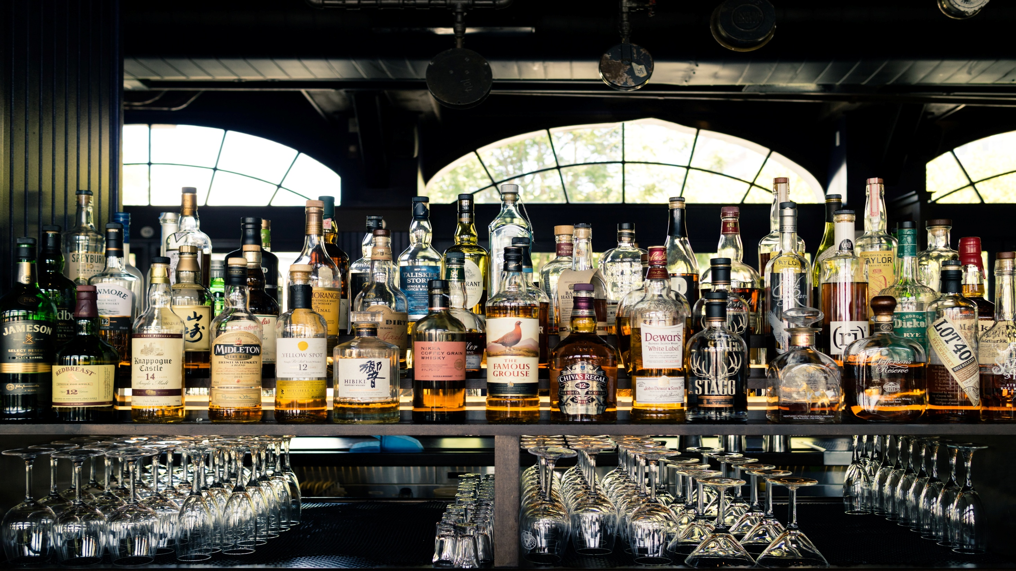
Brand Asset Valuator (Y&R)
Brand Strength
Brand Stature
Differentiation
Esteem
Same packaging for 20 years
Price-value perception is low
Considered as ‘’for oneself’’
Youth connection was missing
Relevance
Knowledge
Lacks saliency
Has lapsed users
Highly known in its current users
Its brand name symbolizes status

Slide 10
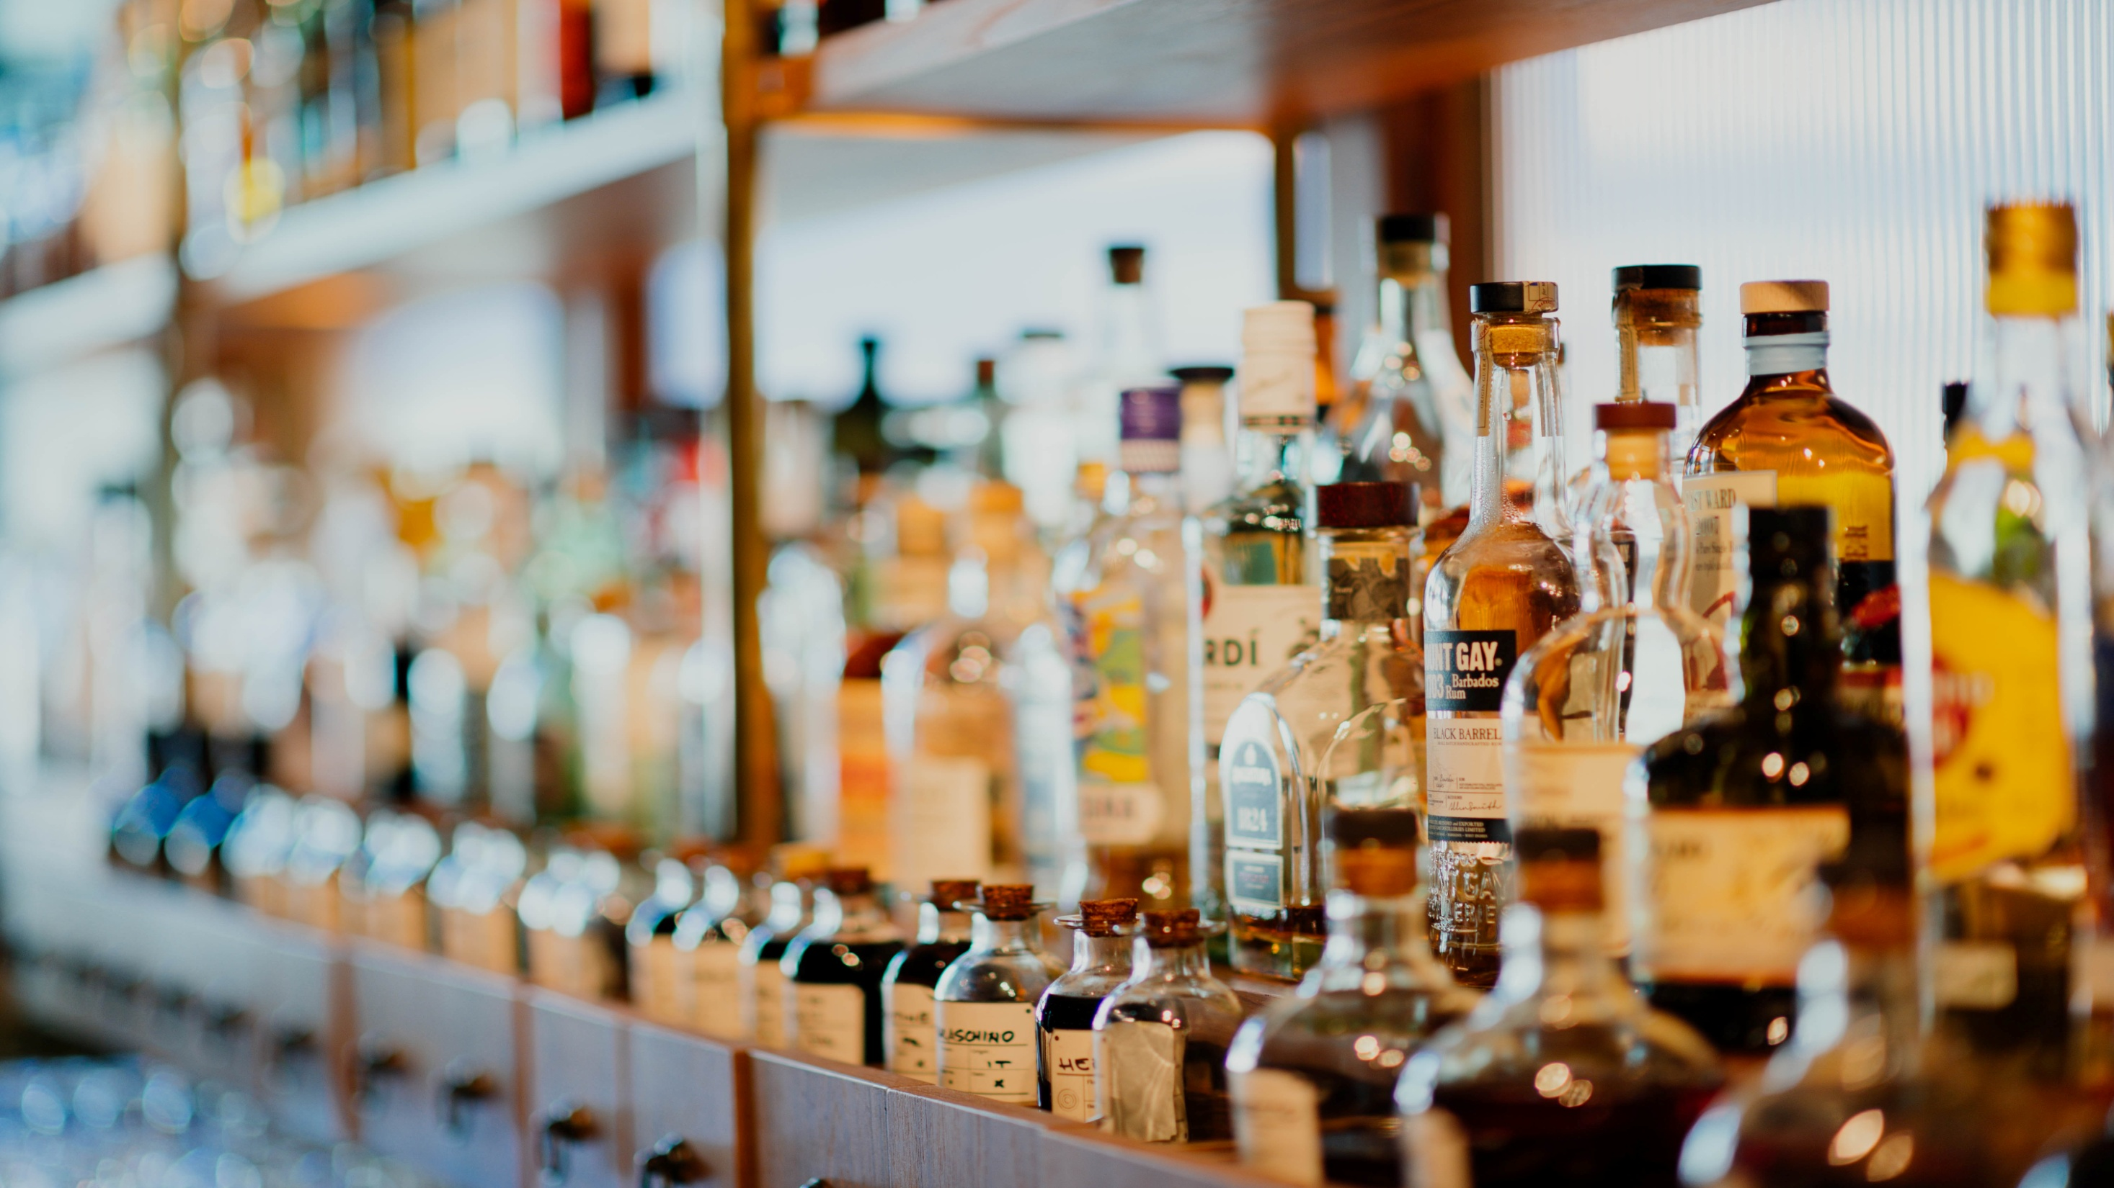
Brand Asset Valuator(Y&R)
Eroding Potential
D
R
E
K
D - Differentiation
R - Relevance
E - Esteem
K - Knowledge

Slide 11

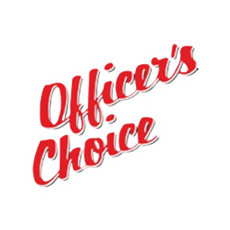

1.Repackaging
2.Repositioning
3.Reconnecting

Slide 12

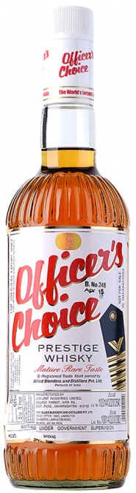
1.Repackaging
OLD
NEW
Dull, staid and sober
Lacked premium feel
Good shelf appeal with new age look
Maintained authenticity
Winner
Modern look
Officer's kind of style

Slide 13

2.Repositioning
Existing positioning-'Challenge Yourself' which was not differentiable wrt to other brands
Regular whisky consumers –sense of recognition key motivator
Old and outdated positioning wrt to today's consumer
Price value perception is low wrt to other competitors
OCW was seen as too mature and serious
Research on why drink OCW?? Taste and strong bond to the title officer
Roy focused on the word 'disruptive' for new campaign
The new campaign was positioned on righteousness and aims to awaken the officer in you.

Slide 14

3.Reconnecting
Need for comprehensive integrated marketing communication
Amplify the new positioning statement through TVCs, radio spots, outdoor and other traditional media.
Advertising both in ATL as well BTL
Use of huge hoardings sites, gantries, pole kiosks, rickshaw backs, bus shelters, shop signage etc to spread the brand image.
Brand achieved good recognition and was able to connect with consumers by focussing on celebrate the contribution and achievement of the common man

Slide 15






How companies can showcase their product
Word of mouth
loyalty programs for customer retention
Associating with bars and parties
Free samples at bars
Affiliate marketing
Customer as the brand ambassador

Slide 16
Current Scenario
Since 2009, ABD has expanded its portfolio by entering several other segments and launching new brands; Jolly Rogers (2010), Officer's Choice Blue (2011), Sterling Reserve (2017)
In 2018, OCW franchise crosses the 34 million 9L-cases and becomes the world's largest selling whisky.
In 2021, OCW grew stronger in comparison(11.5%) to the regular whisky segment(8.9%).
Market share increased from 35.6% (2019-20) to 36.2%.
OCW has lost consumers due to lowered salience of the Cheap and Deluxe whisky brands.
OCW looks forward to re-crafting packaging and consumer communication in contemporary manner.
Source: ABD annual report FY2020-21, https://www.abdindia.com/media/ze3lgxek/abd-annual-report-fy2020-21.pdf

Slide 17
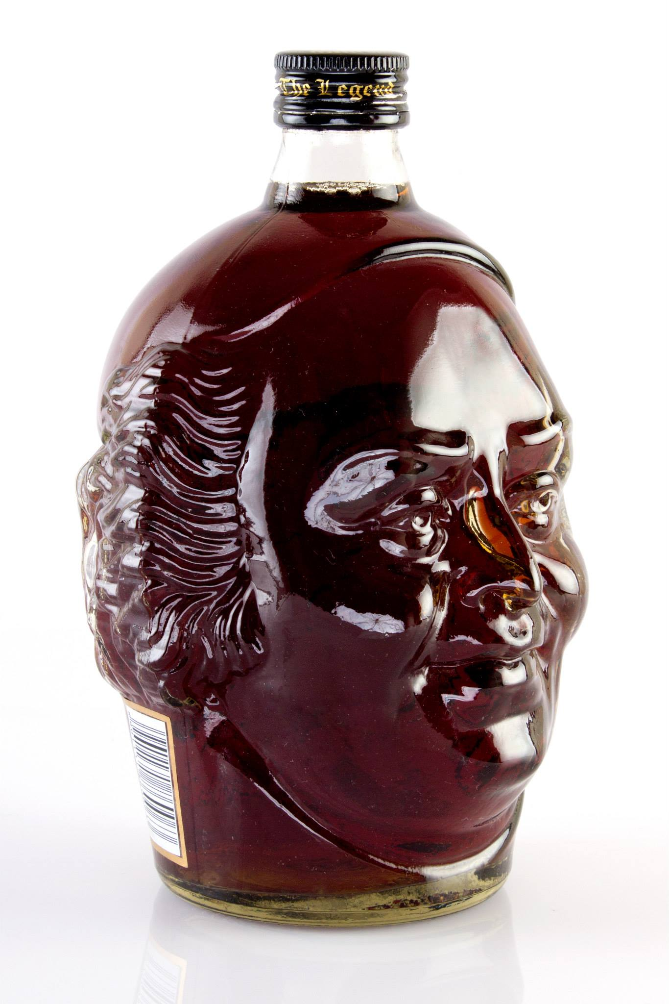

Thank
You
Student's
Choice

